Slide 1





Remote Home Automation System
BIRLA INSTITUTE OF TECHNOLOGY
Project Presentation On The Topic:-

Slide 2
Group Members:-
Roll No | Name | Branch
DL/25/22 | Rounak Anand | ECE
D/50/21 | Guru Gaurav | ECE

Slide 3
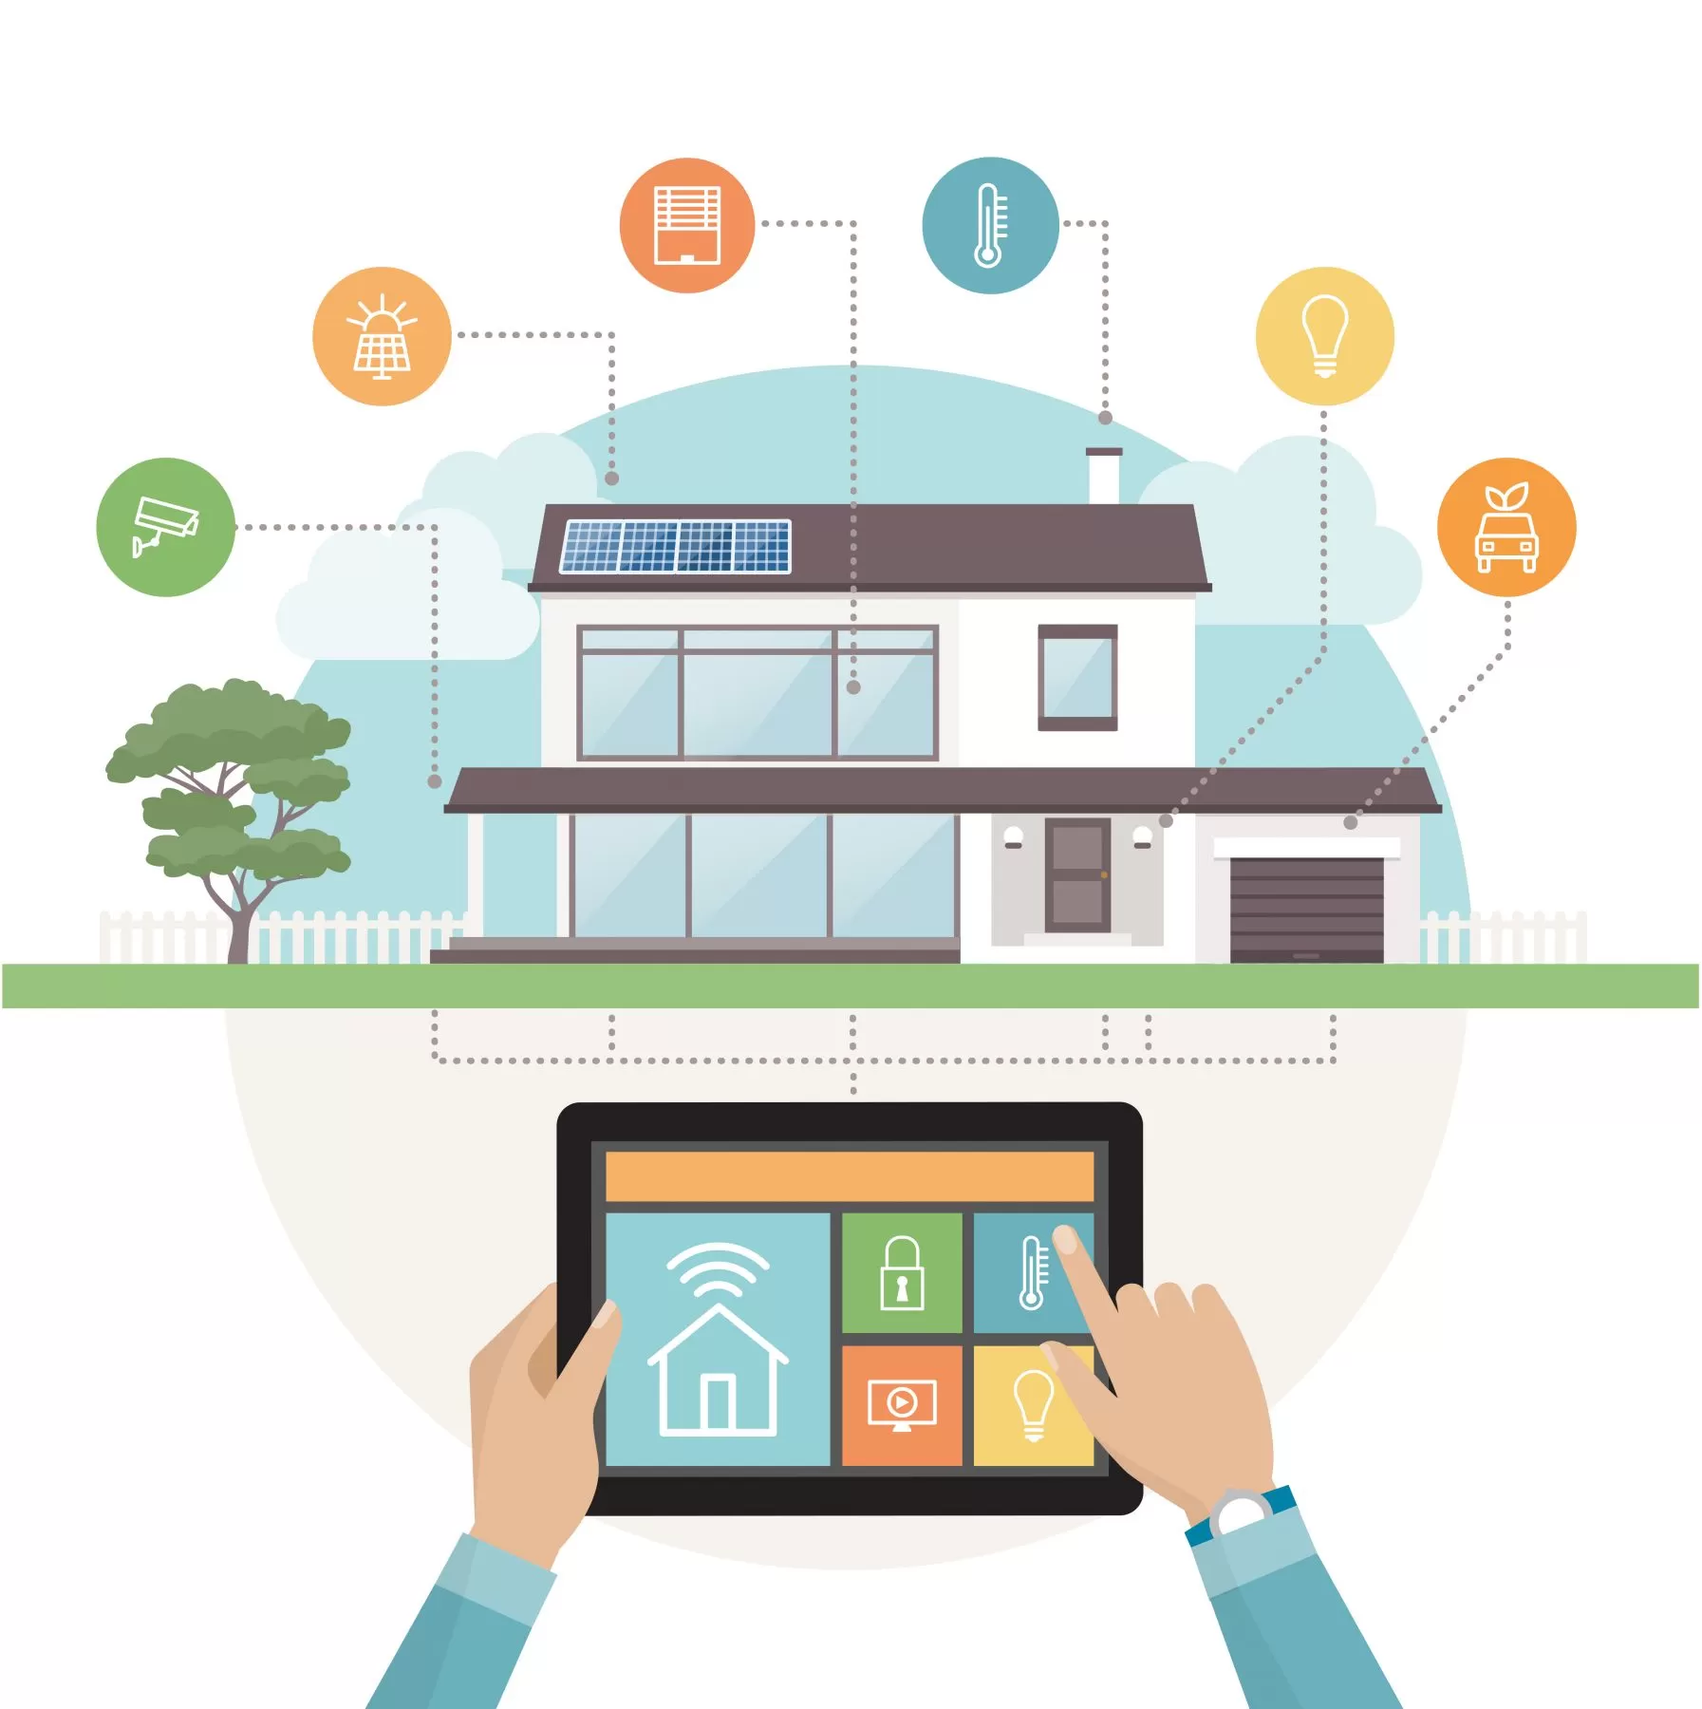
Introduction
In this project , A remote home automation system is designed which can be controlled by smartphone. The automation system connects with the smartphone through Bluetooth Module HC 05. The smartphone sends control signals to switch LEDs ON and OFF by an android app Remote XY through Bluetooth interface.

Slide 4
Components Required :-
01
04
02
05
03
06
Arduino Uno
Jumper Wires
Bluetooth Module
Led Bulb
Relay Module
Bulb Holder

Slide 5
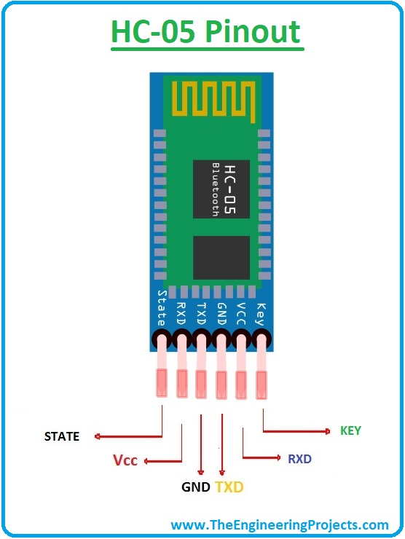
Feature of Key Component :-
Bluetooth Module :- (HC-05 ) it is use to integrate Bluetooth technology to enable wireless communication between devices.
Operating voltage:+5v
Operating current:5mA
Range:10 meters
Pin1: (Key) This pin is used to toggle between data modes (set low) and (set high).
Pin2:(VCC) This pin is used to power the module.
Pin3:(GROUND) This pin is used to connect to system ground.
Pin4:(Tx) Everything received via Bluetooth will be given out by this pin as serial data.
Pin5:(Rx) Every serial data given to this pin will be broadcasted via Bluetooth.
Pin6(State) It is used as a feedback to check if Bluetooth is working properly.

Slide 6
Working :-
Bluetooth Communication:
The system uses a Bluetooth module (HC-05) to establish a wireless communication link between the smartphone and the Arduino Uno.
Signal Reception:
When the user sends a command from the smartphone app, the Bluetooth module receives this signal and sends it to the Arduino Uno.
Command Processing:
The Arduino Uno is programmed to listen for incoming signals from the Bluetooth module. It processes these signals to determine the action to be taken.
Bulb Control:
When the relay closes the circuit (relay is activated), current flows, and the bulb turns on. When the relay opens the circuit (relay is deactivated), the current stops, and the bulb turns off.
User Interface:
The smartphone app provides a user-friendly interface for sending on/off commands to the Arduino, allowing the user to control the bulbs remotely.

Slide 7
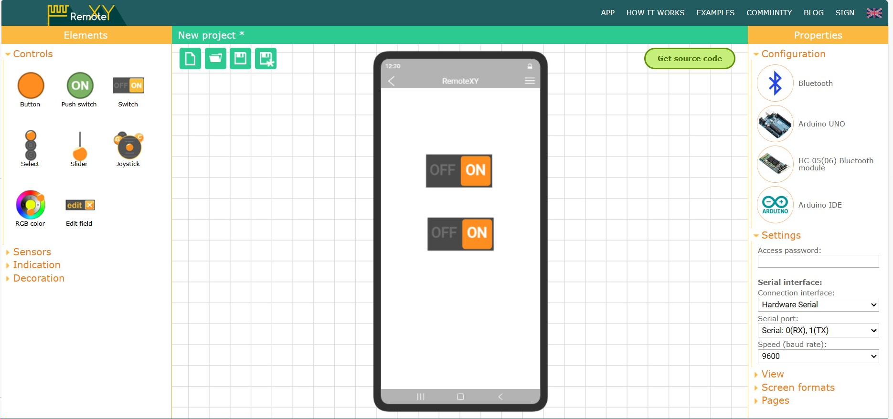
Steps To Create Interface Using RemoteXY:-
First Select The Configuration As Required And Then Select the Serial Interface Setting

Slide 8
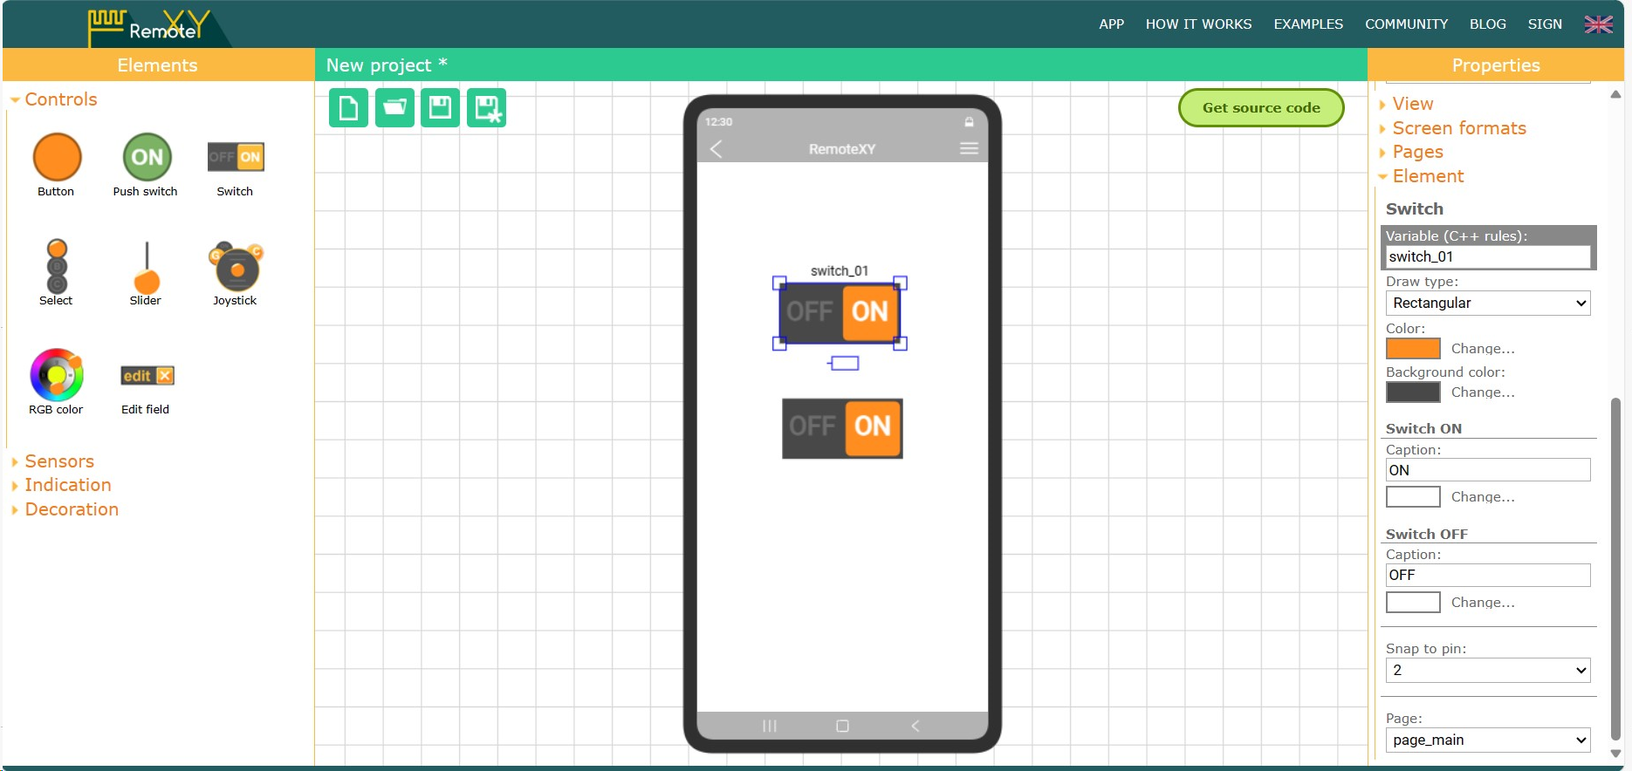
Step 2:-
Now, Select The Snap To Pin For First Relay

Slide 9
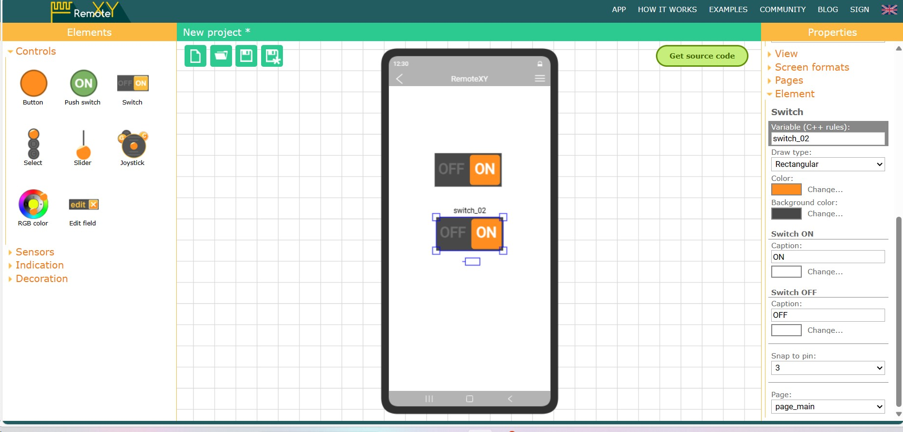
Step 3:-
Now , Select The Snap To Pin For Second Relay

Slide 10
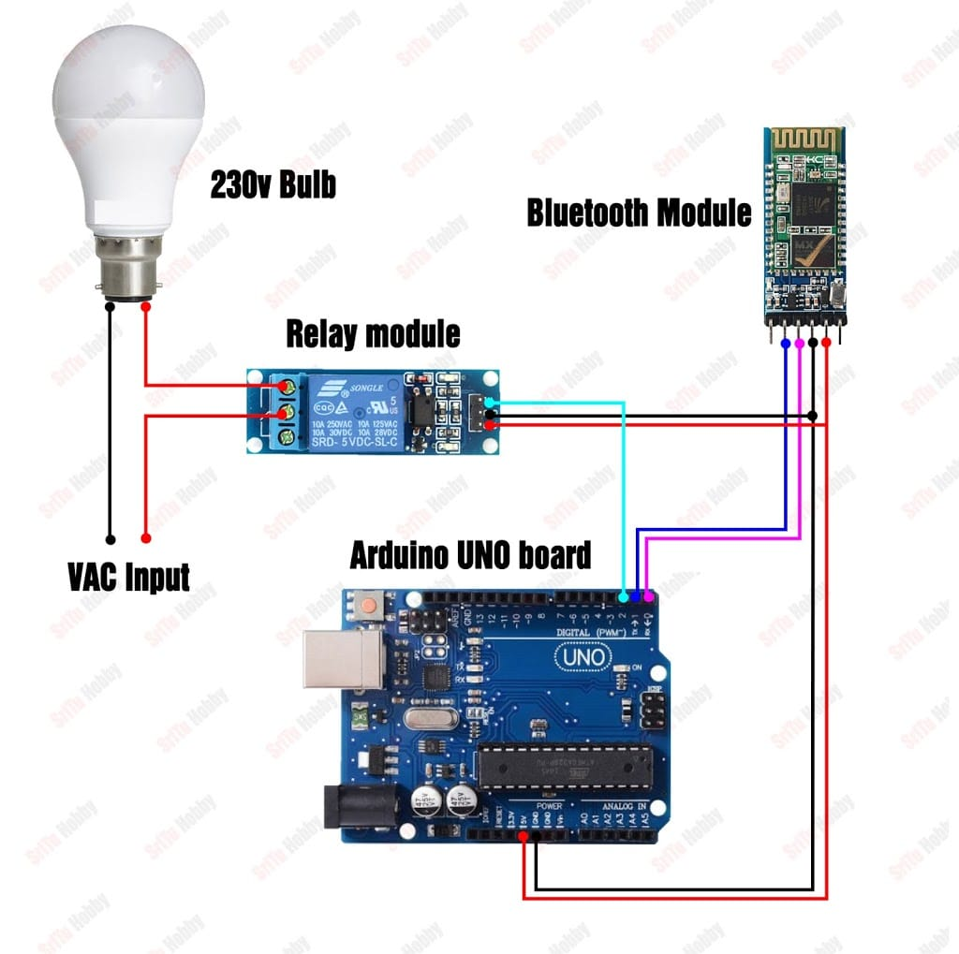
Circuit Diagram

Slide 11
Reference:-
Niraj Sir Assistant Professor, CSE, University Polytechnic ,Birla Institute OF Technology, Ranchi. (For advising And Guiding Us In This Project).
Remote XY .
Internet Of Things.

Slide 12
Thank You !

